Slide 1

RFID Based Retail System
Stallion Systems & Solution Pvt Ltd
Sales@stallionindia.com

Slide 2
RFID (an overview)
Radio Frequency Identification describes the use of radio frequency signals to provide automatic identification of items.
RFID is a flexible technology that is convenient, easy to use, and well-suited for automatic operation. It combines advantages not available with other identification technologies.
RFID does not require contact or line-of-sight to operate, can function under a variety of environmental conditions, and provides a high level of data integrity. In addition, because the technology is difficult to counterfeit, RFID provides a high level of security.
Notes:
2

Slide 3
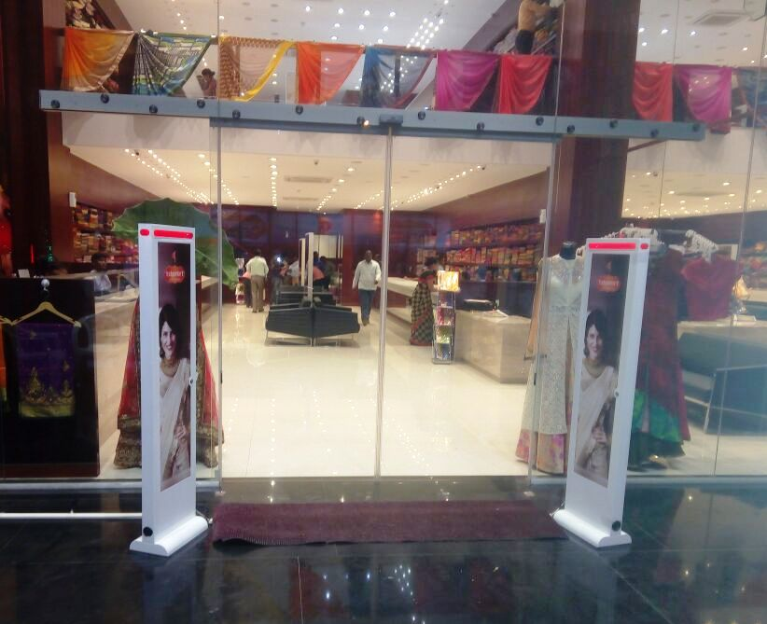

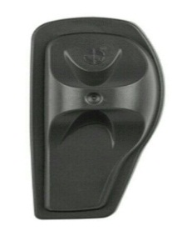

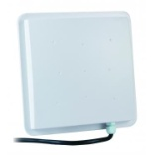
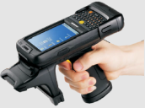
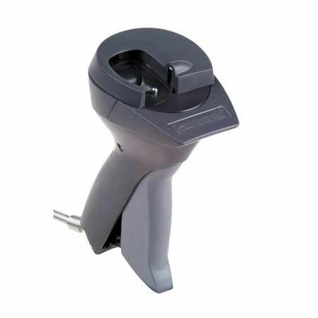
RFID Based Retail System
RFID Retail Application
RFID Tag
STA Anti-theft Gate reader
Physical Audit
Registration & POS
Double Check Point

Slide 4


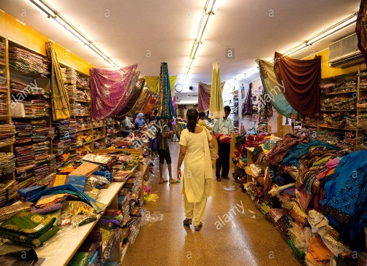


Centralized Store Architecture
Cloud Server
Data on finger tip
Main Store
Store - 01
Store - 02

Slide 5
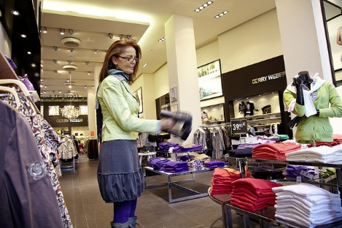
MERCHANDISE VISIBILITY™ (RFID) SOLUTIONS
$400 million market growing at 40%
Stallion Global is the only full-service solutions provider
Hardware
Software
Worldwide installation and service
Tags and labels
Growing global list of RFID engagements
Currently running 2+ pilots & 1+ Implementation

Slide 6
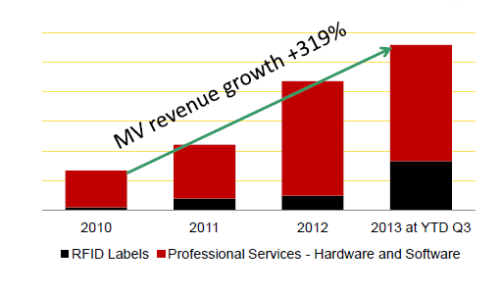
TRANSFORMING RFID PILOTS INTO LIVE ROLL-0UTS
Stallion Global Differentiators
Enterprise RFID leader and innovator – 6+ years of implementations
Full spectrum of multi-mode use cases to support every store format /business model - hands-free, handheld, fixed, overhead, pedestal
One Tag – single solution for both inventory management at item level and loss prevention
Enterprise class software meets IT requirements for scalability, security, centralized management and network architecture
Patent license gives retailers protection from potential litigation

Slide 7
EXTENDING RFID BEYOND INVENTORY MANAGEMENT
RFID-Enabled Inventory Management
RFID-Enabled Loss Prevention
RFID-Enhanced Customer Experience
RFID-Enabled Supply Chain
•Improve inventory accuracy
•Reduce out-of-stocks
•Reduce working capital
•Source tag to reduce in-store task labour
•+2% increase in inventory accuracy leads to +1% sales lift
•Leverage single RFID tag for inventory and loss prevention (LP)
•Restock stolen items to ensure merchandise availability
•Integrate LP and inventory data to uncover patterns of theft
•Improve merchandise availability
•Enable additional merchandising options, enhance store layout flexibility
•Support mobile POS, e-receipts, self-checkout
•Optimize Omni-channel inventory
•Source tag to reduce labour costs, improve compliance
•Gain visibility into inventory location and movement
•Extend LP protection to cargo theft, vendor fraud, counterfeiting and diversion
Retailers are deploying RFID for maximum merchandise visibility across the supply chain.

Slide 8
INVESTMENT THESIS
Revenue growth with continued margin and OPEX improvements
Strong global brand with extensive installed base and recurring revenues
Continuous stream of retailers switching from #1 competitor to Stallion Group’s EAS/RFID solutions
RF technology superiority…gaining market share worldwide
Worldwide sales and service capability
Best-in-class RFID technology supports merchandise availability strategy
Apparel Labelling Solutions appropriately structured to deliver RFID consumables
Strong balance sheet

Slide 9
Business Benefits
Achieving Accuracy, Reliability and Availability of process data (with 100% read rates and ability to port data into existing systems, this enables for data based decision making leading to competitive advantage)
Enhancing operational speed and increased productivity
RFID System independent of the skill level of operator (easy to use & simple, this ensures faster adoption in existing processes)
Enhanced Supply Chain visibility through greater control over inventory
Reduction in overall Operating Costs

Slide 10
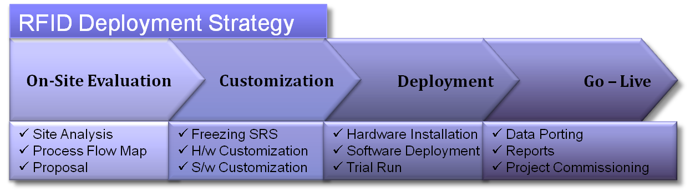
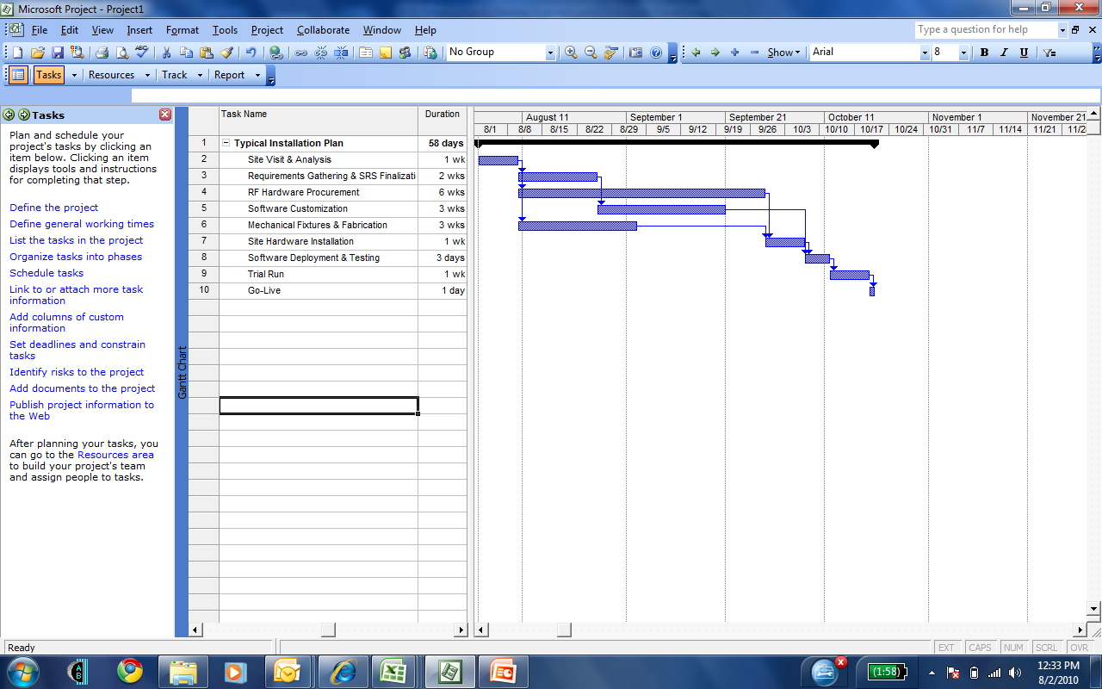
Implementation - Methodology
Sample Project Plan
* Typical Hardware Procurement Lead Time varies between 5 – 9 weeks.

Slide 11
